Slide 1

Language Generation with Neural Networks
Eric Zander | LinkedIn

Slide 2
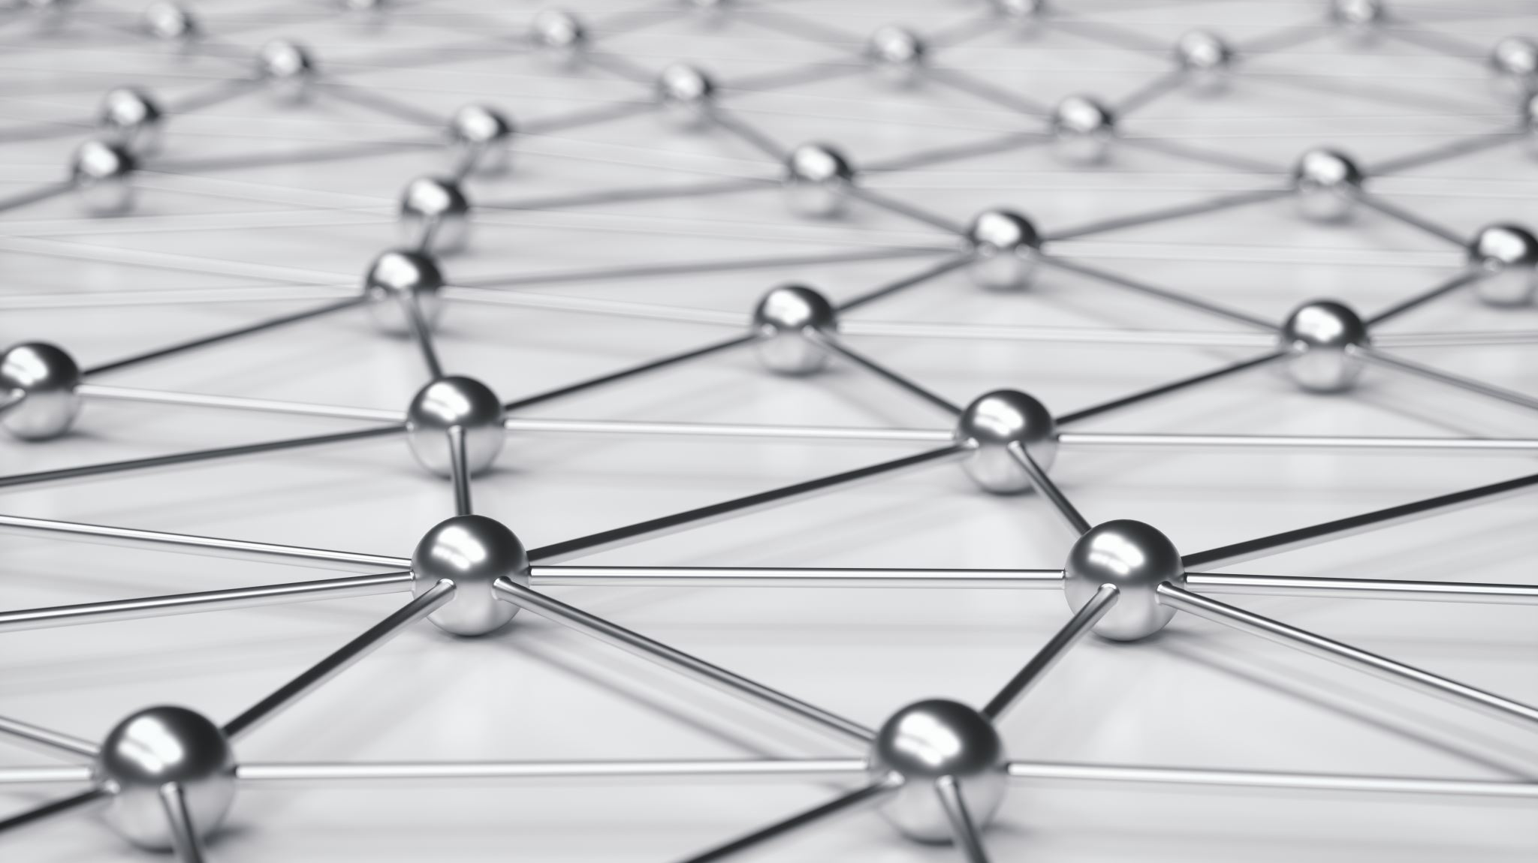
Neural Networks

Slide 3
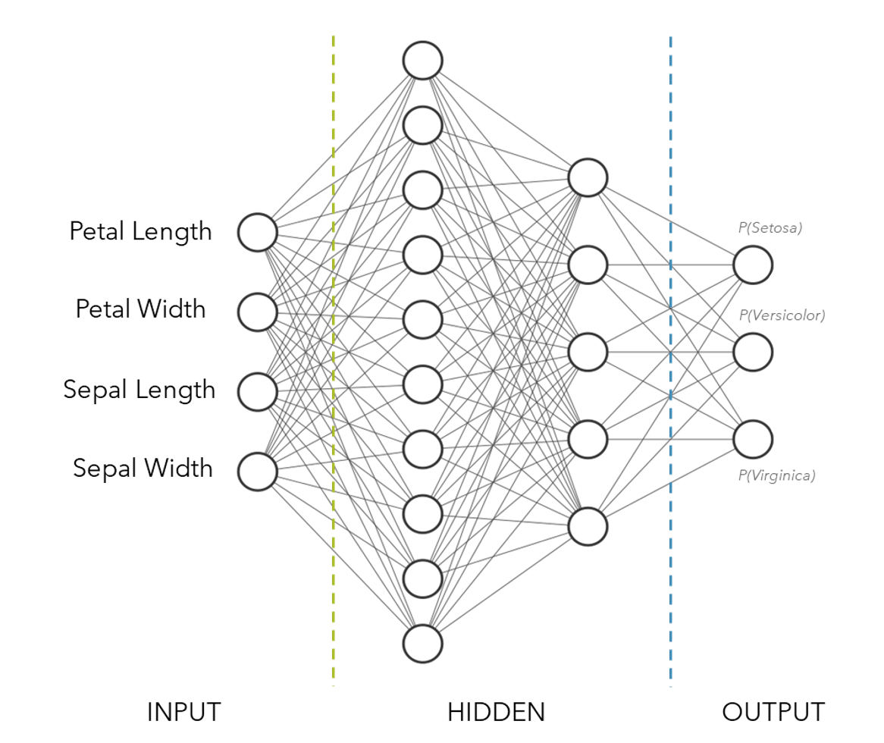

Slide 4









Embedding
Transforming words into numbers
Usually vectors of scalars
Many approaches
Dictionary
One-hot
Neural network
Word2Vec
ELMo
Transformer-based
$$\left[\begin{aligned}0.2 \\ 1.4 \\ 0.2 \\ 3.6 \\ 0.3 \\ 0.1 \\ 0.5 \\ 2.1 \\ 3.2 \\ 3.8 \\ 1.1 \\ 0.5\end{aligned}\right]$$
$$\left[\begin{aligned}hello \\ , \\ how \\ are \\ you \\ ?\end{aligned}\right]$$

Slide 6
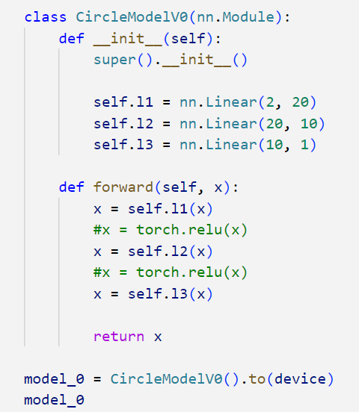
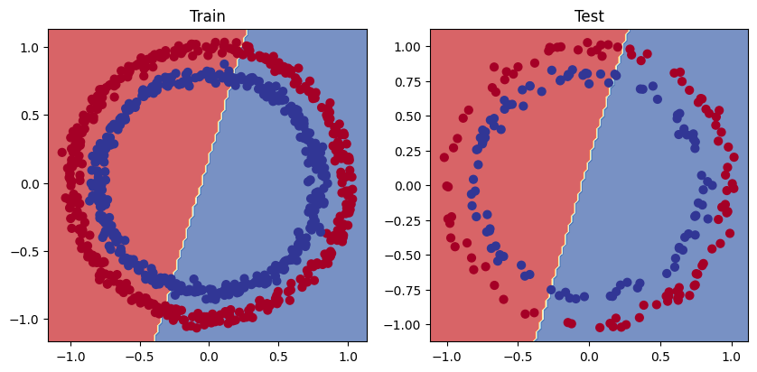
Nonlinearity
Using code by Daniel Bourke

Slide 7
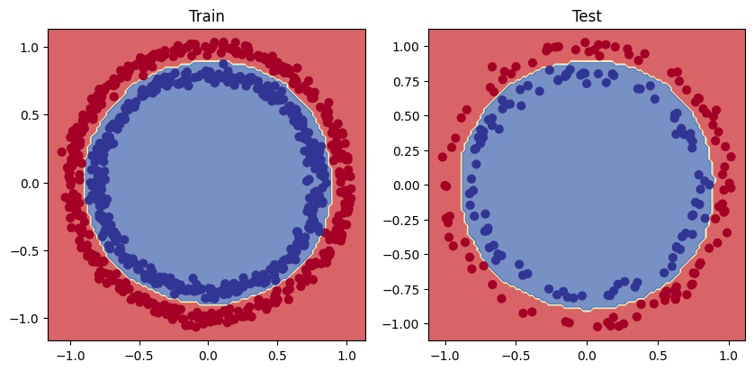
Nonlinearity
Using code by Daniel Bourke

Slide 9
[8, 7, 2, 4, 5, 3, 2, 1]

Slide 10
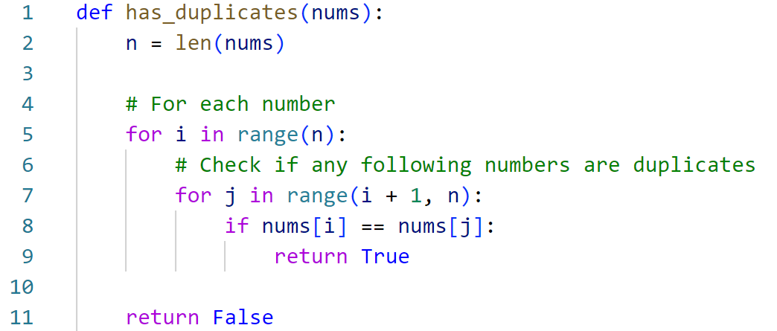
[8, 7, 2, 4, 5, 3, 2, 1]
O(n²)

Slide 11
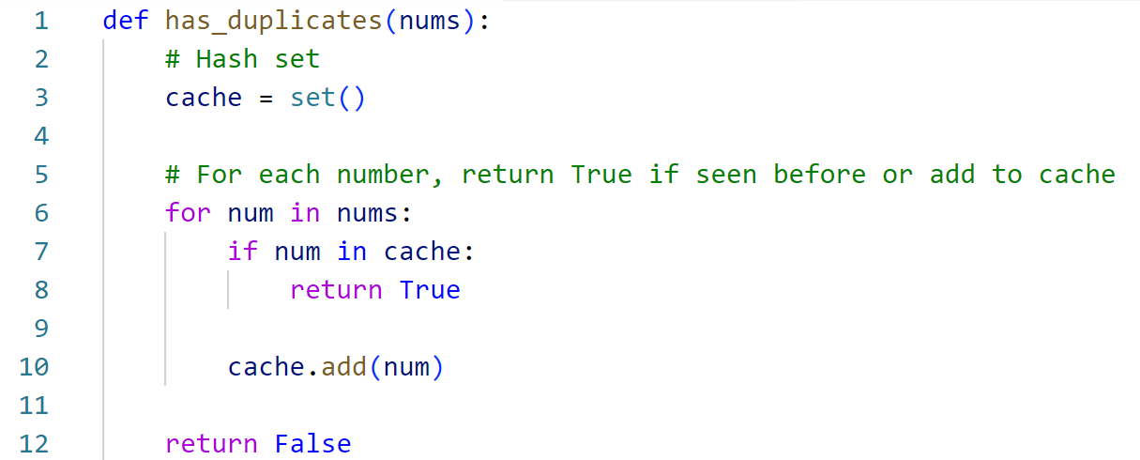
[8, 7, 2, 4, 5, 3, 2, 1]
O(n)

Slide 13
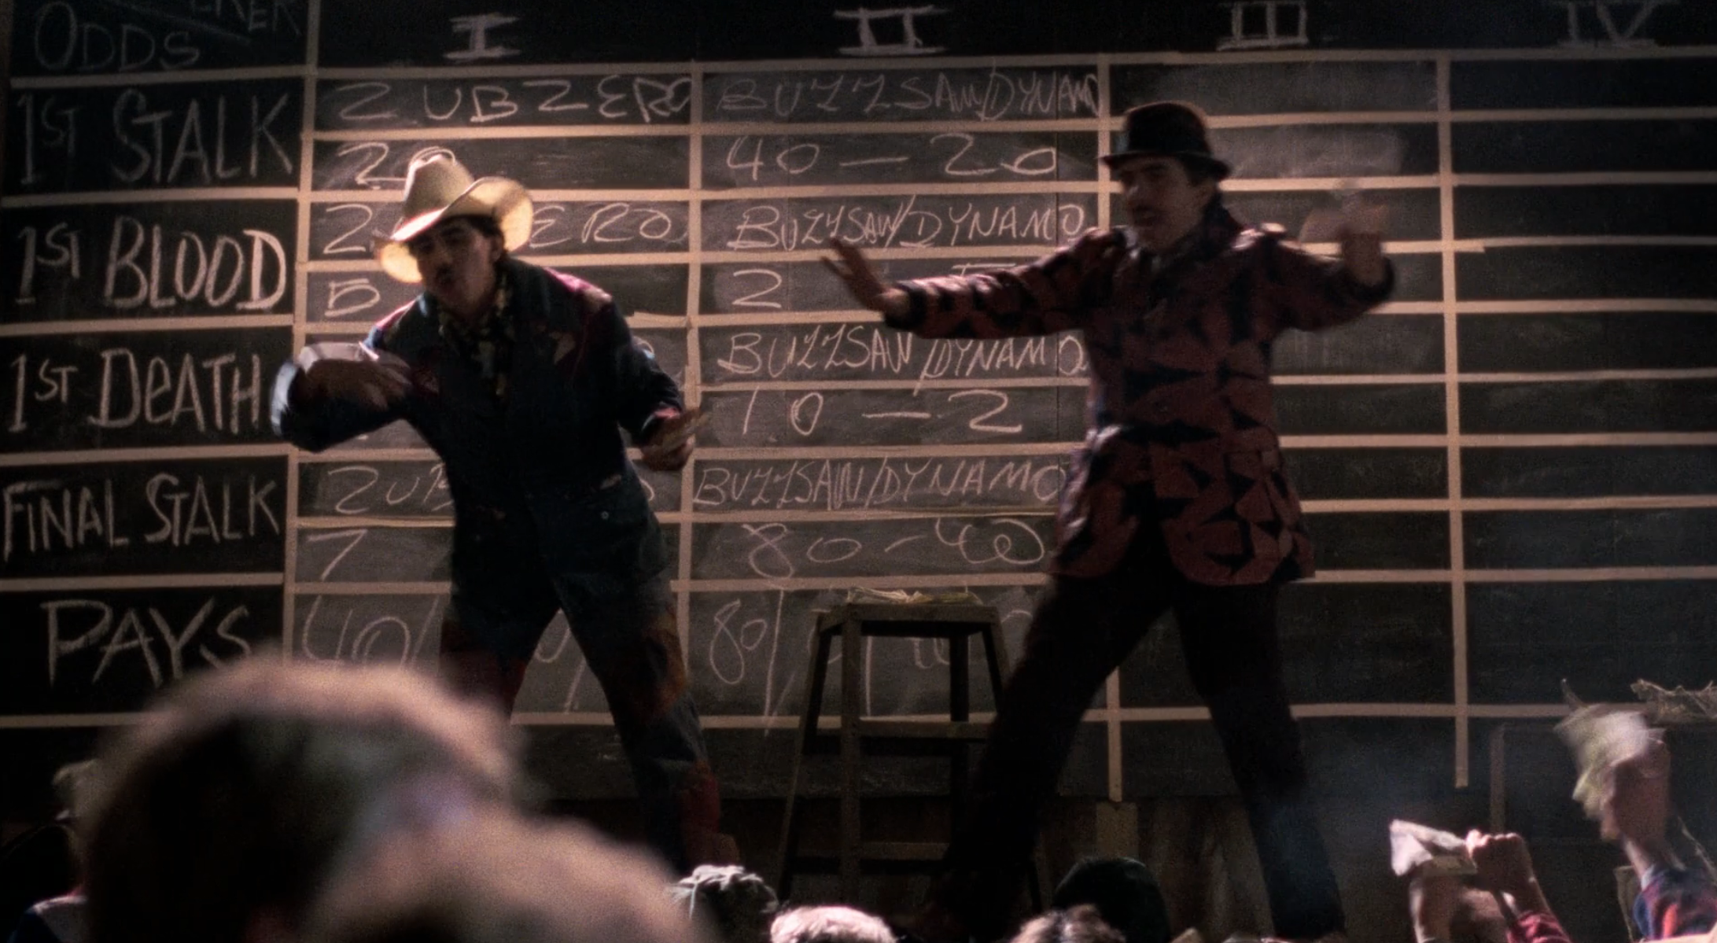
Probability, Odds, and Logits

Slide 14
Probability
[0, 1]
0.8
0.2

Slide 15
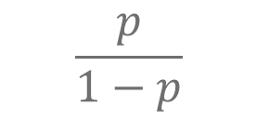
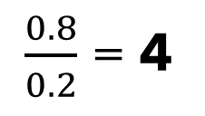
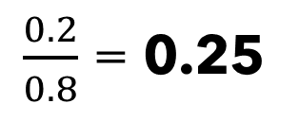
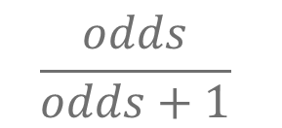
Probability
Odds
[0, 1]
[0, ∞)
$$\frac{p}{1−p}$$
0.8
$\frac{0.8}{0.2}$ = 4
0.2
$\frac{0.2}{0.8}$ = 0.25
$$\frac{odds}{odds+1}$$

Slide 16

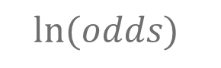
Probability
Odds
Logits
[0, 1]
[0, ∞)
(-∞, ∞)
$$\frac{p}{1−p}$$
$$ln⁡(odds)$$
0.8
$\frac{0.8}{0.2}$ = 4
~1.4
0.2
$\frac{0.2}{0.8}$ = 0.25
~-1.4
$$\frac{odds}{odds+1}$$
$$elogit$$

Slide 17
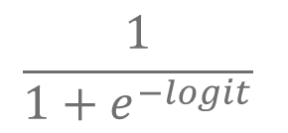
Probability
Odds
Logits
[0, 1]
[0, ∞)
(-∞, ∞)
$$\frac{p}{1−p}$$
$$ln⁡(odds)$$
0.8
$\frac{0.8}{0.2}$ = 4
~1.4
0.2
$\frac{0.2}{0.8}$ = 0.25
~-1.4
$$\frac{odds}{odds+1}$$
$$elogit$$
$$\frac{1}{1+e^{−logit}}$$

Slide 18
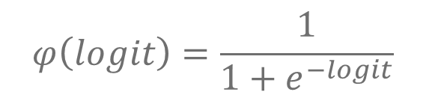
Probability
Odds
Logits
[0, 1]
[0, ∞)
(-∞, ∞)
$$\frac{p}{1−p}$$
$$ln⁡(odds)$$
0.8
$\frac{0.8}{0.2}$ = 4
~1.4
0.2
$\frac{0.2}{0.8}$ = 0.25
~-1.4
$$\frac{odds}{odds+1}$$
$$elogit$$
$$φ\left(logit\right)=\frac{1}{1+e^{−logit}}$$
Sigmoid Function!

Slide 19

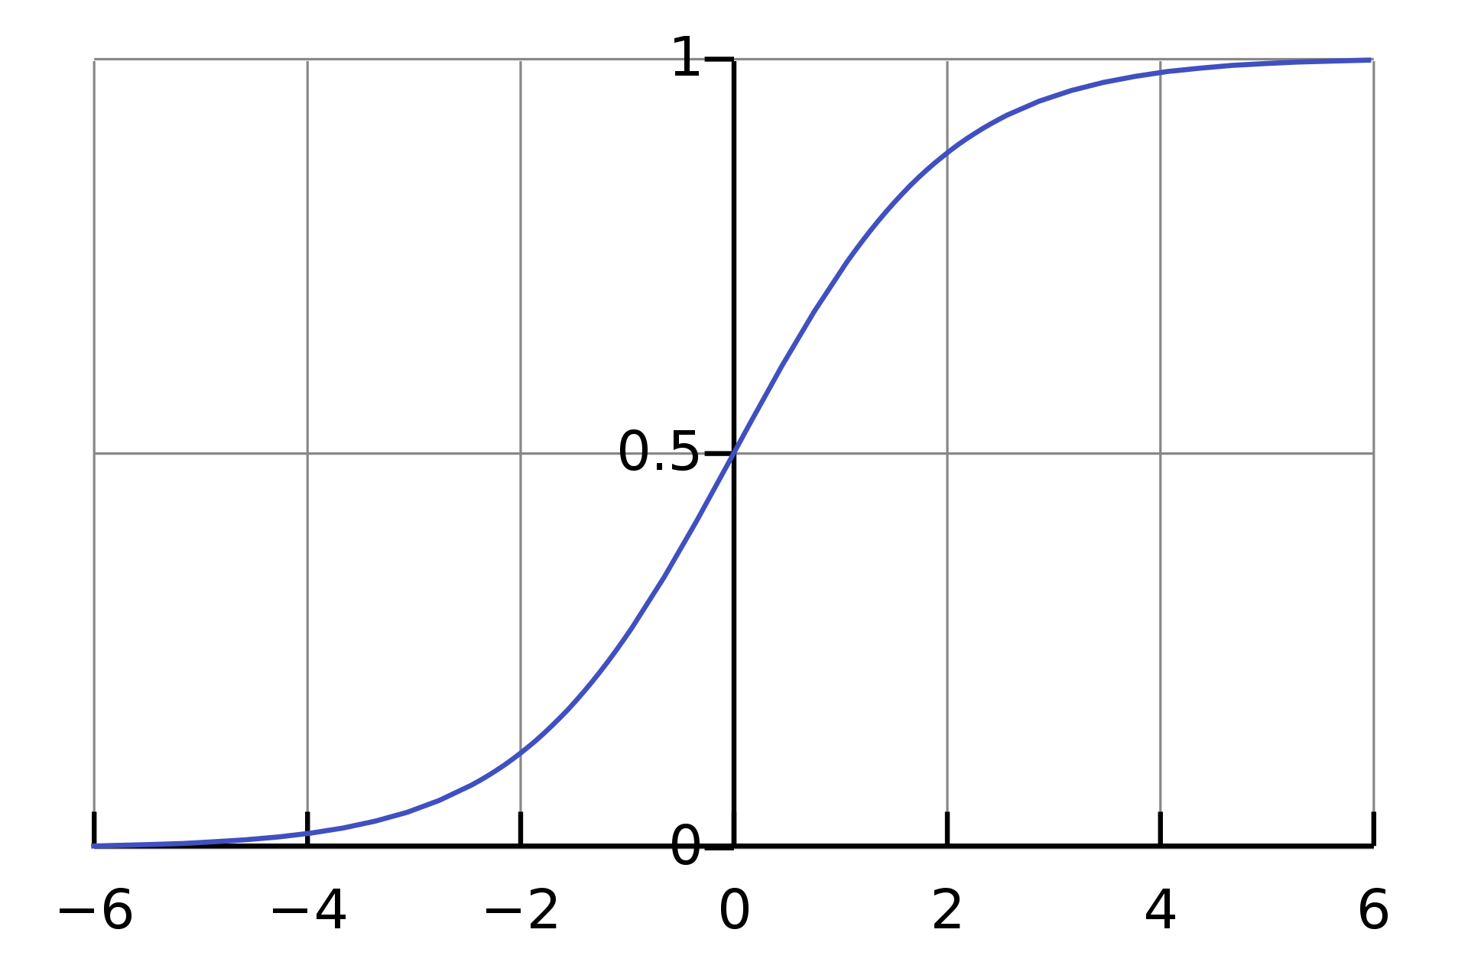
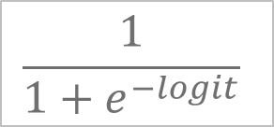
Sigmoid Activation
$$\frac{1}{1+e^{−logit}}$$
Converts a logit to a probability
Used for binary classification output
Comparable to logistic regression

Slide 20
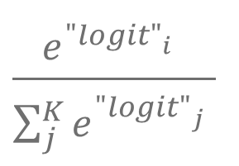


Probability
Odds
Logits
[0, 1]
[0, ∞)
(-∞, ∞)
$$\frac{p}{1−p}$$
$$ln⁡(odds)$$
0.8
$\frac{0.8}{0.2}$ = 4
~1.4
0.2
$\frac{0.2}{0.8}$ = 0.25
~-1.4
$$\frac{odds}{odds+1}$$
$$elogit$$
Softmax function?
$$\frac{e^{{"logit"}_{i}^{}}}{\sum_{j}^{K}{e^{{"logit"}_{j}^{}}}}$$

Slide 22

Problem Variable Length Input?

Slide 23
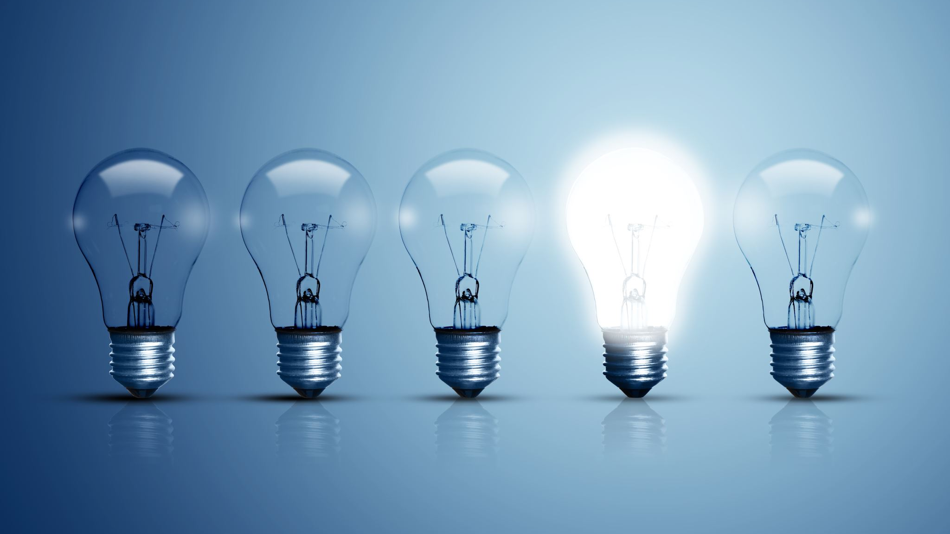
Recurrent Neural Networks (RNNs)

Slide 24

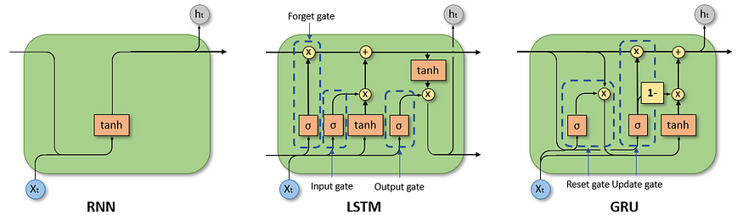
Recurrent Neural Networks (RNN)
Left: A recurrent neural network takes input vector x and gives output vector o by processing each input and an updated hidden state h
By fdeloche - Own work, CC BY-SA 4.0
Right: To combat vanishing gradients for longer sequences, Long Short-Term Memory (LSTM) units or Gated Recurrent Units (GRU) can be used appropriately supplement the hidden state
Input &
Hidden State
Input, Cell State, &
Hidden State
Input &
Hidden State
Dancker, 2022

Slide 25
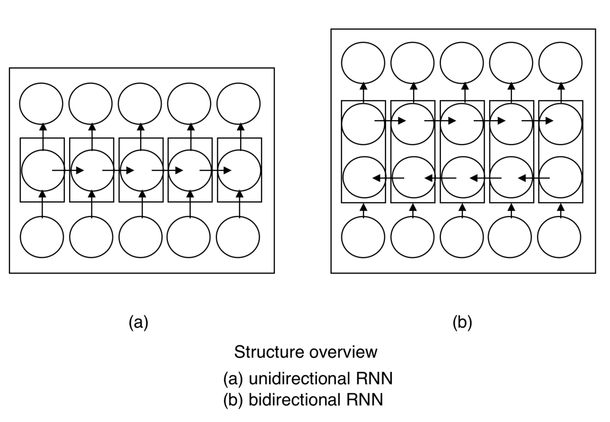
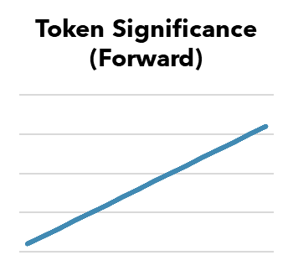
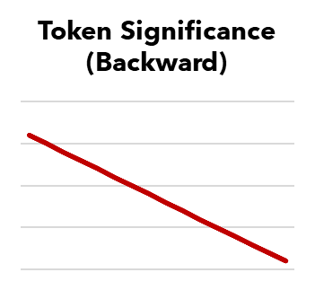
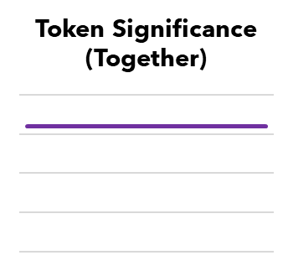
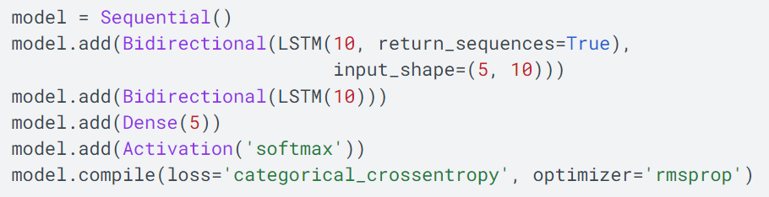
Bidirectional RNNs
+
By Incfk8 - Own work, CC BY-SA 4.0
=
TensorFlow implementation

Slide 26

Problem Variable Length Output & Causality

Slide 27
Example: Translation
Hello
,
how
are
you
?
Ciao
,
come
stai
?
Model

Slide 28

Language Generation

Slide 29
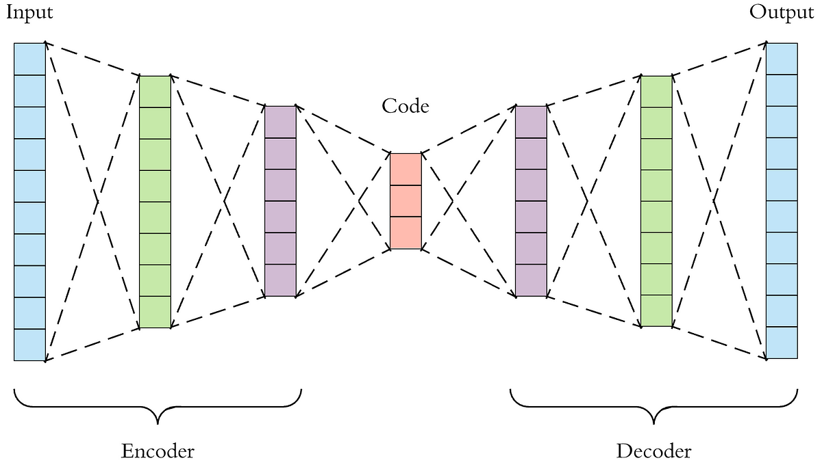
Autoencoders? VAEs?
Dertat, 2017

Slide 30
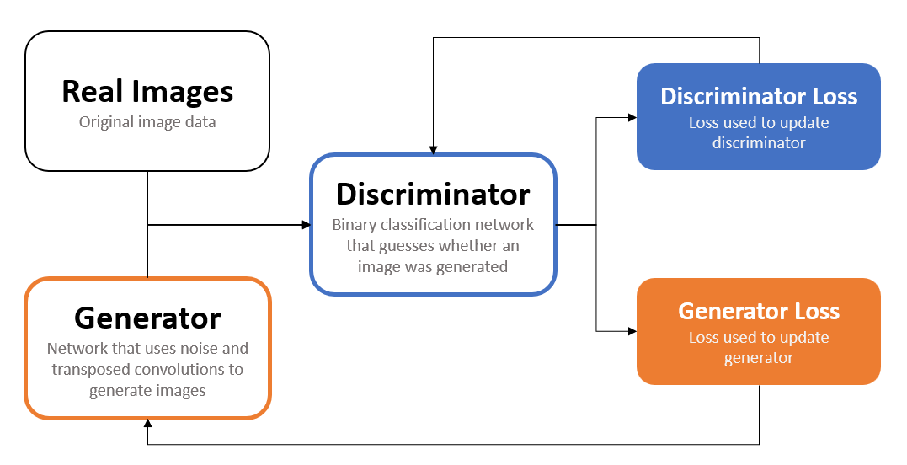
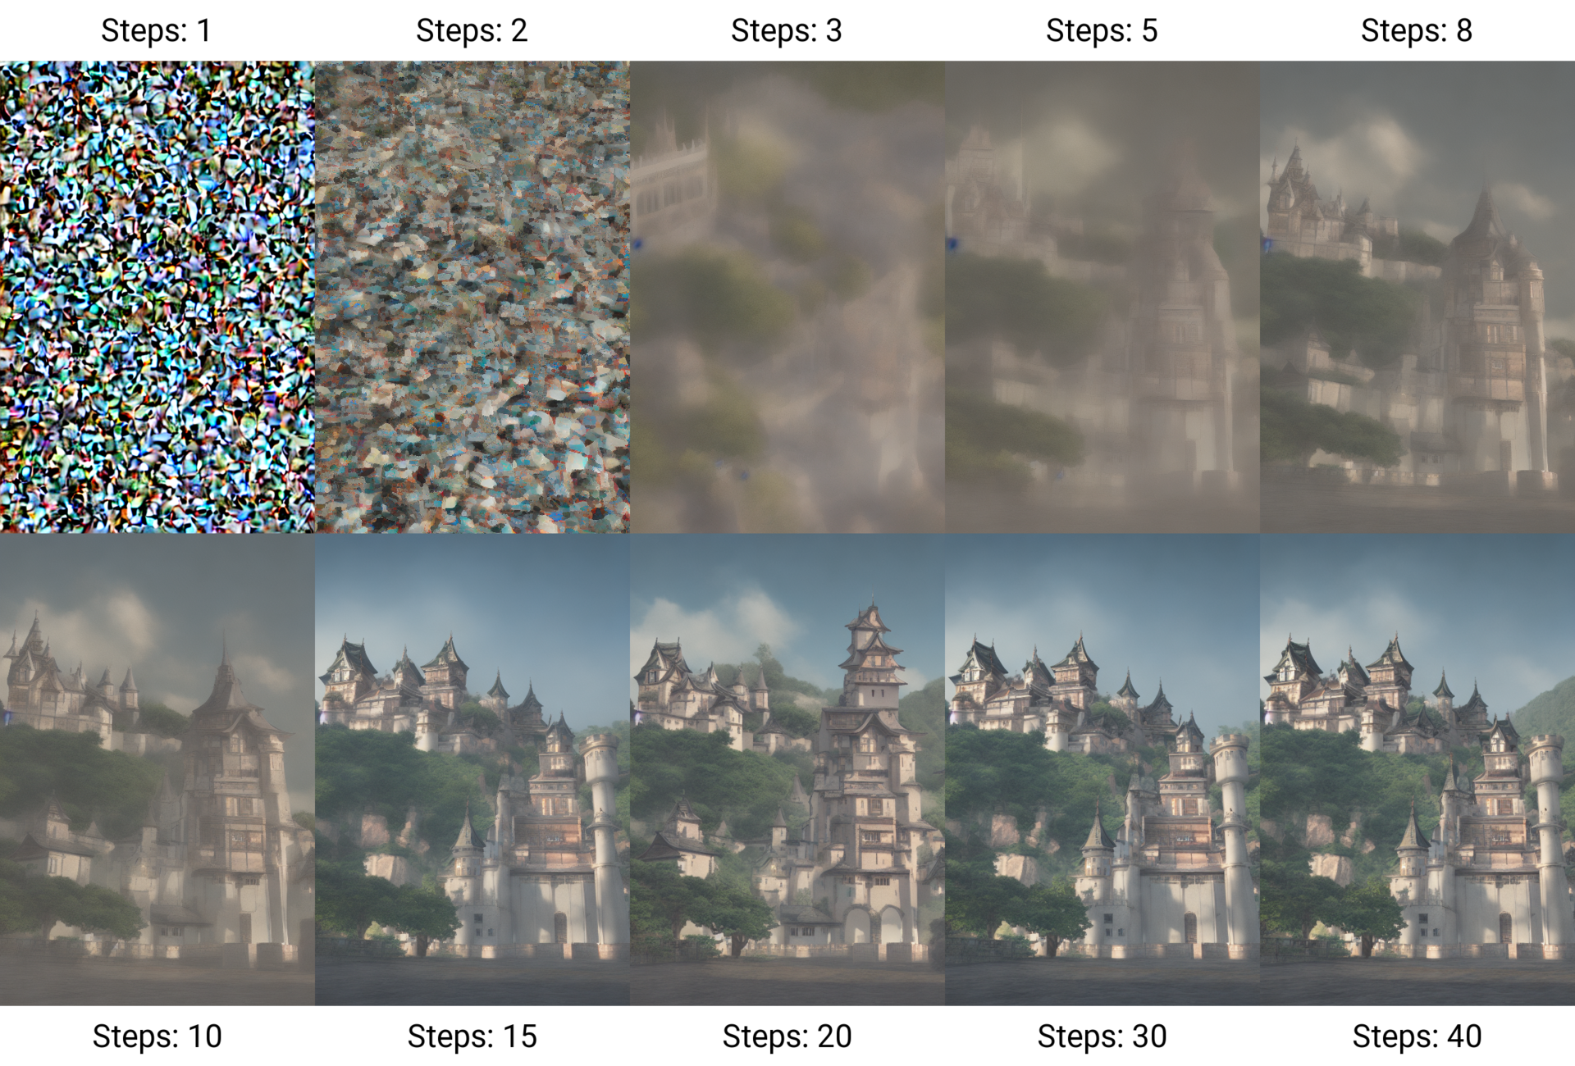
GANs? Diffusion Models?
Above: Flowchart describing the training of a Generative Adversarial Network (GAN)
Right: Illustration of the denoising process underlying diffusion models.
By Benlisquare - Own work, CC BY-SA 4.0

Slide 31
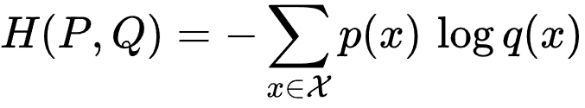
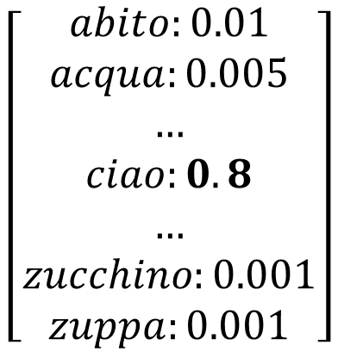
Actually… Classification
Possible value comparison
Pixel intensity (8-bit RGB)
256³ = 16,777,216 values
English words
~170,000 (in current use)
Pretty large compared to other languages
There are several tricks for reducing vocabulary
Tokenization methods, lemmatization, etc.
Otherwise, use brute force
Big models
Big datasets
Big investment
$$\left[\begin{aligned}abito:0.01 \\ acqua:0.005 \\ … \\ ciao:0.8 \\ … \\ zucchino:0.001 \\ zuppa:0.001\end{aligned}\right]$$

Slide 32
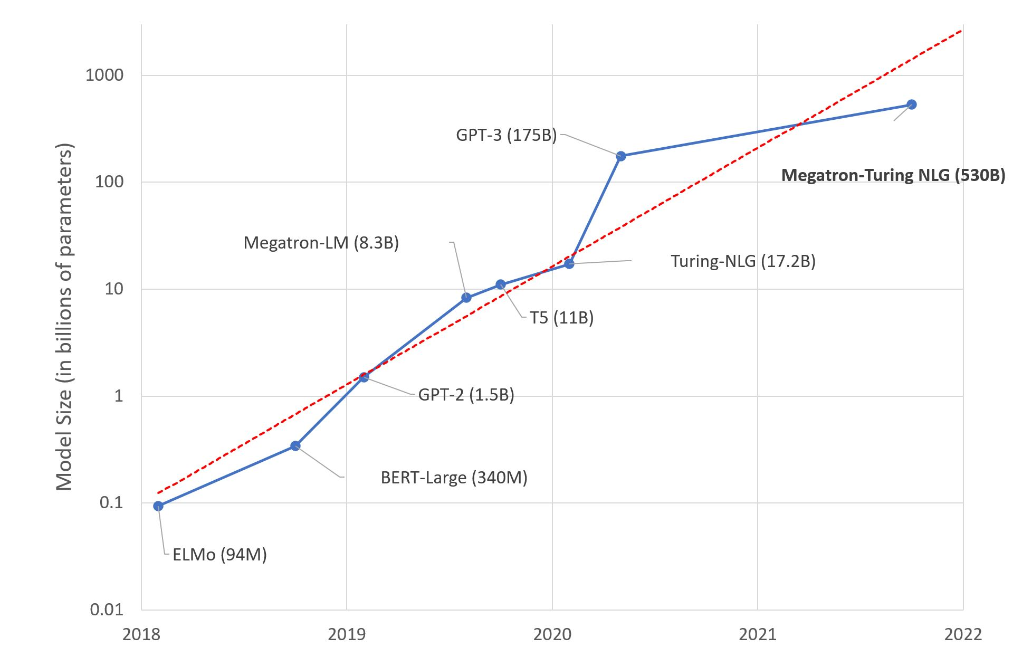
Large Language Models: A New Moore’s Law?
Simon, Hugging Face, 2021

Slide 33




Encoder-Decoders!
Transformer architecture,
Vaswani et al., 2016

Slide 34












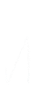

















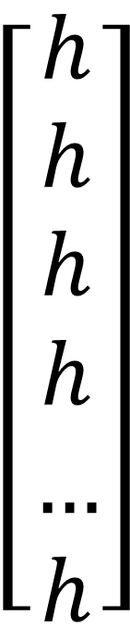
Encoding (RNN)
Example
$$\left[\begin{aligned}h \\ h \\ h \\ h \\ … \\ h\end{aligned}\right]$$
Hello
,
how
are
you
?
Encoded ← Input
Dertat, 2 |

Slide 35
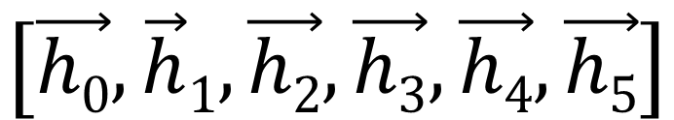
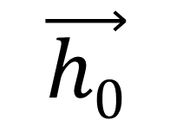
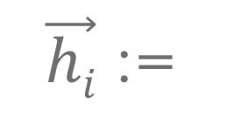
Preparing to Decode (RNN)
Encoded Input
Hidden State
$$\left[\vec{h0},\vec{h}1,\vec{h2},\vec{h3},\vec{h4},\vec{h5}\right]$$
$$\vec{h0}$$
“Hello , how are you ?”
(start with final input state)
Input
(i.e. Previous Output)
Hidden states (scalars) for each recurrent unit at the i^{th} time step
$\vec{hi}$ :=
<BOS>
(dummy starting token)

Slide 36





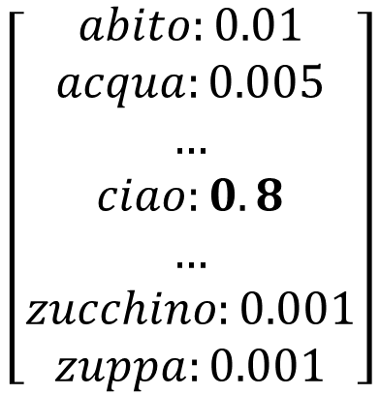
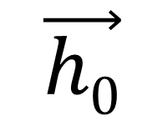






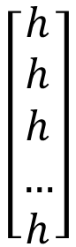
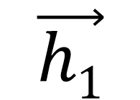











Decoding (RNN)
$$\left[\begin{aligned}h \\ h \\ h \\ … \\ h\end{aligned}\right]$$
$$\vec{h0}$$
$$\vec{h1}$$
$$\left[\begin{aligned}abito:0.01 \\ acqua:0.005 \\ … \\ ciao:0.8 \\ … \\ zucchino:0.001 \\ zuppa:0.001\end{aligned}\right]$$
<BOS>
ciao
“Hello , how are you ?”
“<BOS>”

Slide 37





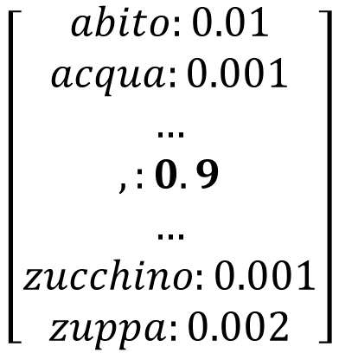
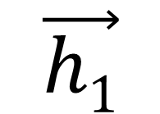






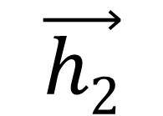











Decoding (RNN)
$$\left[\begin{aligned}h \\ h \\ h \\ … \\ h\end{aligned}\right]$$
$$\vec{h1}$$
$$\vec{h2}$$
$$\left[\begin{aligned}abito:0.01 \\ acqua:0.001 \\ … \\ ,:0.9 \\ … \\ zucchino:0.001 \\ zuppa:0.002\end{aligned}\right]$$
ciao
,
“Hello , how are you ?”
“<BOS> ciao”

Slide 38
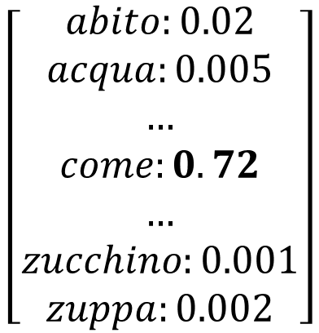
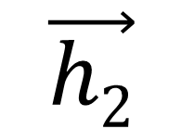
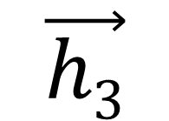
Decoding (RNN)
$$\left[\begin{aligned}h \\ h \\ h \\ … \\ h\end{aligned}\right]$$
$$\vec{h2}$$
$$\vec{h3}$$
$$\left[\begin{aligned}abito:0.02 \\ acqua:0.005 \\ … \\ come:0.72 \\ … \\ zucchino:0.001 \\ zuppa:0.002\end{aligned}\right]$$
,
come
“Hello , how are you ?”
“<BOS> ciao , ”

Slide 39
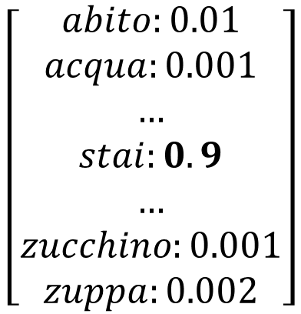
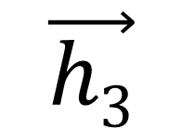
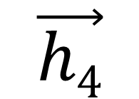
Decoding (RNN)
$$\left[\begin{aligned}h \\ h \\ h \\ … \\ h\end{aligned}\right]$$
$$\vec{h3}$$
$$\vec{h4}$$
$$\left[\begin{aligned}abito:0.01 \\ acqua:0.001 \\ … \\ stai:0.9 \\ … \\ zucchino:0.001 \\ zuppa:0.002\end{aligned}\right]$$
come
stai
“Hello , how are you ?”
“<BOS> ciao , come”

Slide 40
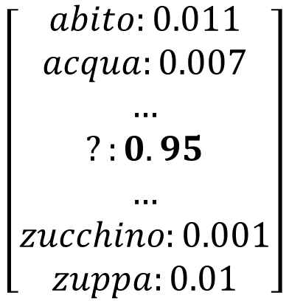


Decoding (RNN)
$$\left[\begin{aligned}h \\ h \\ h \\ … \\ h\end{aligned}\right]$$
$$\vec{h4}$$
$$\vec{h5}$$
$$\left[\begin{aligned}abito:0.011 \\ acqua:0.007 \\ … \\ ?:0.95 \\ … \\ zucchino:0.001 \\ zuppa:0.01\end{aligned}\right]$$
stai
?
“Hello , how are you ?”
“<BOS> ciao , come stai”

Slide 41



Decoding (RNN)
$$\left[\begin{aligned}h \\ h \\ h \\ … \\ h\end{aligned}\right]$$
$$\vec{h5}$$
$$\vec{h6}$$
$$\left[\begin{aligned}abito:0.001 \\ acqua:0.002 \\ … \\ <EOS>:0.9 \\ … \\ zucchino:0.001 \\ zuppa:0.01\end{aligned}\right]$$
?
<EOS>
“Hello , how are you ?”
“<BOS> ciao , come stai ?”

Slide 42

Another Example
Zhang et al., 2021

Slide 43
seq2seq
Umbrella term for this encoder-decoder framework
Applications
Translation
Speech recognition
Text summarization
Code translation/generation
Image captioning
RNN-based models have some limitations
Difficulties with long-range dependencies
Issues with scalability (sequential processing of input)

Slide 44




Transformers: more than meets the eye
Transformer architecture,
Vaswani et al., 2016

Slide 45

Positional Encoding

Slide 46





1st
2nd
3rd
Transformer Neural Networks, ChatGPT’s foundation, Clearly Explained!!!,
StatQuest with Josh Starmer, YouTube, 2023

Slide 47

Attention
Mechanism for prioritizing information
Uses simple matrix multiplications
Highly parallelized
Supports some explainability techniques
Can be used in many contexts
With RNNs
On its own
Non-NLP tasks
Attention heatmap,
Bandanau et al., 2015

Slide 48


Keys, Values, and Queries
Keys (K)
Represents inputs (form)
Values (V)
Represents inputs (content)
Queries (Q)
Element for which attention needs to be calculated
K
V
Q
Encoder self-attention
K
V
Q
Decoder cross-attention

Slide 49













Slide 50




































































Projection Matrices
(Learned Network Weights)

Slide 51








Attention Scores
(Scaled Dot Products)
Projection Matrices
(Learned Network Weights)

Slide 52






























































































Attention Scores
(Scaled Dot Products)
Projection Matrices
(Learned Network Weights)
Attention Weights
(Softmax)

Slide 53














Attention Scores
(Scaled Dot Products)
Projection Matrices
(Learned Network Weights)
Attention Weights
(Softmax)
Context Vector
(Dot Products)

Slide 54















































































Projection Matrices
(Learned Network Weights)
Attention Scores
(Scaled Dot Products)
Attention Weights
(Softmax)
Context Vector
(Dot Products)
$$Attention\left(Q, K, V\right)=softmax\left(\frac{QK^{T}}{\sqrt{dk}}\right)V$$

Slide 55

Attention in Transformers
Self-attention
K, V, Q from one source
Cross-attention
Q from different source
Multi-head attention
Repeats process with different weights
Produces multiple context vectors
Masked attention
Limits attention to certain tokens
By DancingPhilosopher - Own work, CC BY-SA 4.0

Slide 56


Transformers: more than meets the eye
Transformer architecture,
Vaswani et al., 2016

Slide 57

Pretraining and Fine-Tuning

Slide 58
Pretraining
asdf

Slide 59
Generative Pretrained Transformer (GPT)
Generative Pretrained Transformer (GPT)
Bidirectional Encoder Representations from Transformers (BERT)

Slide 60
Bidirectional Encoder Representations from Transformers (BERT)
Generative Pretrained Transformer (GPT)
Bidirectional Encoder Representations from Transformers (BERT)

Slide 61
Adapting your Model

Slide 62
Reinforcement Learning from Human Feedback (RLHF)

Slide 63
Rule-based Reward Models (RBRMs)

Slide 64
Red Teaming

Slide 65
Exploits

Slide 66
References
J. Dancker. A Brief Introduction to Recurrent Neural Networks, https://towardsdatascience.com/a-brief-introduction-to-recurrent-neural-networks-638f64a61ff4
A. Dertat. Applied Deep Learning – Part 3: Autoencoders, https://towardsdatascience.com/applied-deep-learning-part-3-autoencoders-1c083af4d798
A. Vaswani et al., Attention Is All You Need. arXiv, 2017. doi: 10.48550/ARXIV.1706.03762.
I. Sutskever, O. Vinyals, and Q. V. Le, Sequence to Sequence Learning with Neural Networks. 2014.
A. Zhang, Z. C. Lipton, M. Li, and A. J. Smola, Dive into Deep Learning. 2021.
J. Starmer. Transformer Neural Networks, ChatGPT’s foundation, Clearly Explained!!! StatQuest with Josh Starmer. YouTube. 2023. https://www.youtube.com/watch?v=zxQyTK8quyY&ab_channel=StatQuestwithJoshStarmer
D. Bahdanau, K. Cho, and Y. Bengio, Neural Machine Translation by Jointly Learning to Align and Translate. 2016.
J. Simon. Large Language Models: A New Moore’s Law?, Hugging Face, 2021. https://huggingface.co/blog/large-language-models

Slide 67


Thank you
Presenter name
Email address
Website

